Slide 1

Name: Alec Mabhiza Chirawu
Chinese Name: (亚历克上)
Student Number: M202161029
IT & IC
Information And Engineering Department, USTB
Professor: Qifu TYLER Sun

Slide 2
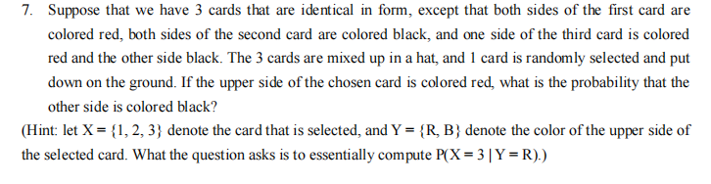
From Problem 1: number 7
Information which is given:
Since we have 3 cards , the probability of picking one of them is:

Slide 3
From Problem 1: number 7
Conditional Probabilities

Slide 4
From Problem 1: number 7
Baye’s rule formula
Applying the formula to our problem we get:
joint probability

Slide 5
From Problem 1: number 7
Baye’s rule formula
The probability that the other side is colored black is :
Applying the formula to our problem we get:

Slide 6
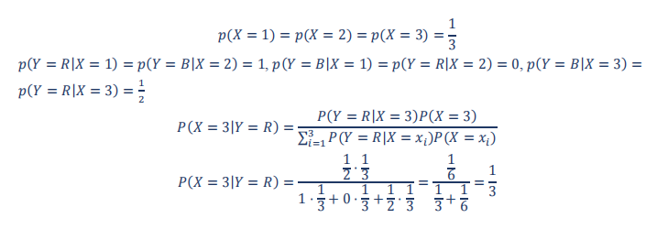
Solution

Slide 7
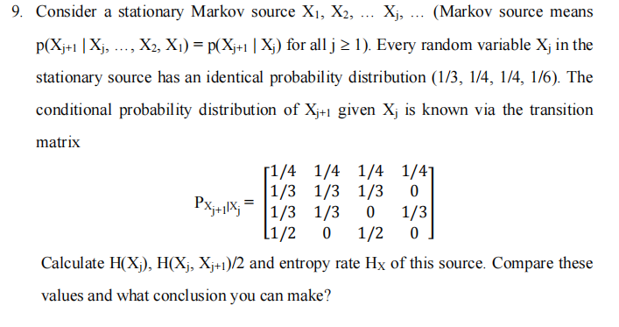
From Problem 2 number 9
verifying that (1/4,3/8,1/4,1/8) is stastionary distribution
1/4*1/3+0*1/4+1/3*1/4+9*1/6 = 1/6

Slide 8
From Problem 2 number 9
verified == 1/4*1/3+0*1/4+1/3*1/4+9*1/6 = 1/6

Slide 9
From Problem 2 number 9
verified == 1/4*1/3+0*1/4+1/3*1/4+9*1/6 = 1/6
conditional entropy by conditioning

Slide 10
From Problem 2 number 9
verified == 1/4*1/3+0*1/4+1/3*1/4+9*1/6 = 1/6

Slide 11
From Problem 2 number 9
verified == 1/4*1/3+0*1/4+1/3*1/4+9*1/6 = 1/6
comparing values:
So we can conclude that : the more random variables considered together, the average entropy will be nonincreasing and approach to the entropy rate.

Slide 12
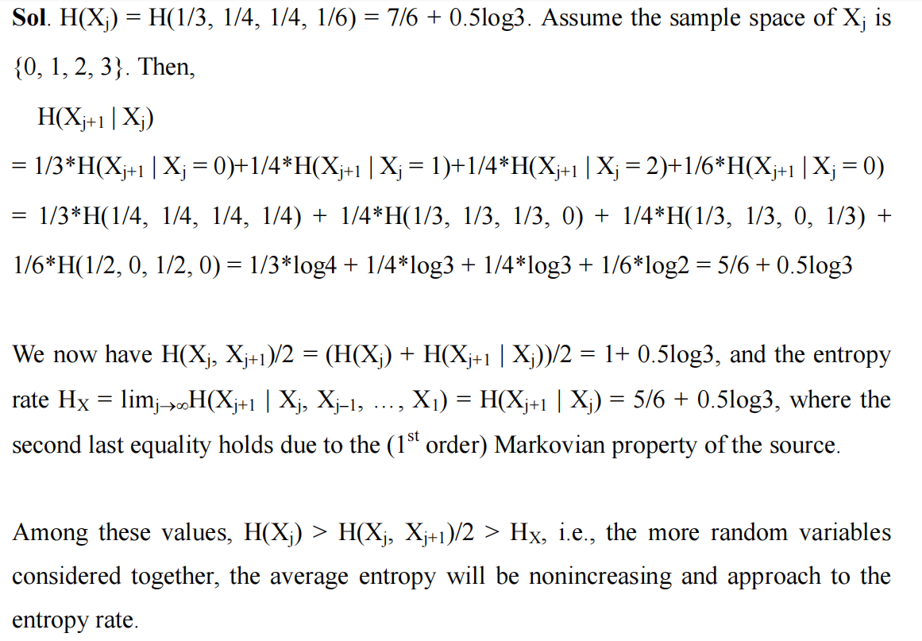
Solution

Slide 13
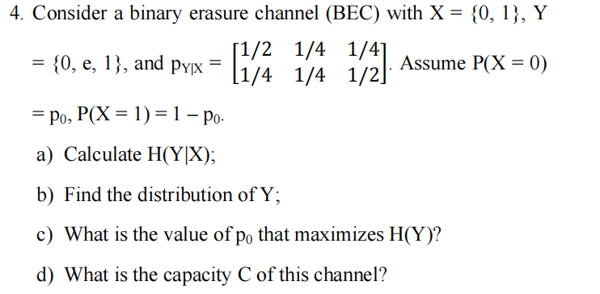
From Problem 3: number 4

Slide 14
From Problem 3: number 4
a)
Distribution of Y

Slide 15
From Problem 3: number 4
a)
b)
to get the value of Po we have to solve (Y=0) =(Y=1)

Slide 16
From Problem 3: number 4
a)
b)
c)
Capacity of this channel is :

Slide 17
From Problem 3: number 4
a)
b)
c)
d)
Capacity of this channel is :

Slide 18
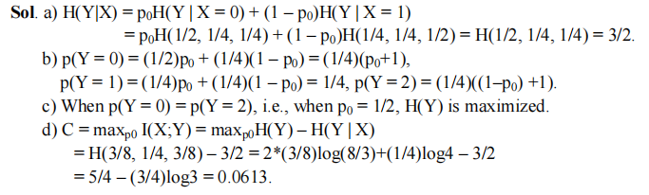
Solution

Slide 19
THANK YOU !!!

